Slide 1
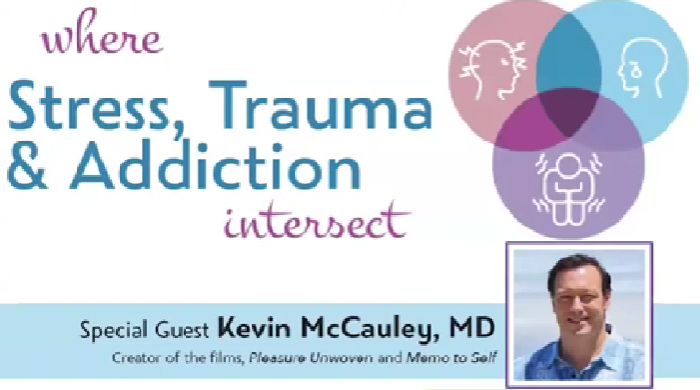
This excellent video by Dr. Kevin McCauley who is a recovering addict and former Navy flight surgeon who lost his career to addiction and went to prison and is now an amazing voice for those who have been taken prisoner by addiction. Please click the link below to listen: https://www.youtube.com/watch?v=PEtWvjMA934&ab_channel=BeaPartoftheConversation Jeffrey E. Hansen, Ph.D. Center for Connected Living, LLC

