Slide 1
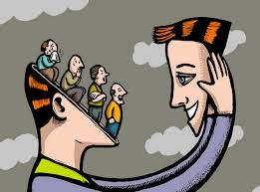
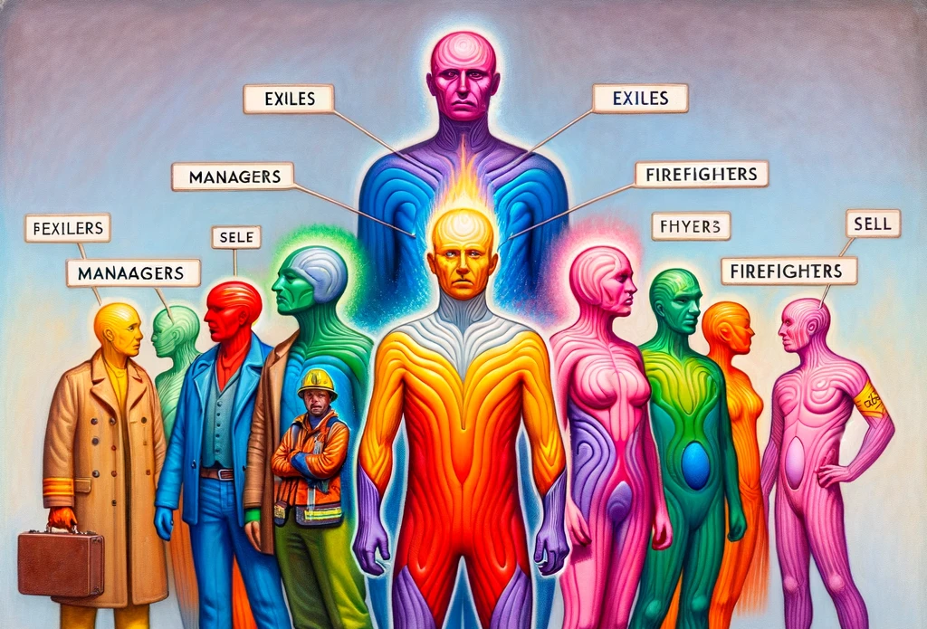
Internal Family Systems (IFS) Therapy – Faith Version
Wholeness is not achieved by cutting off a
portion of one’s being, but by integration
of the contraries.
- C. G. Jung
Jeffrey E. Hansen, Ph.D.
Center for Connected Living, LLC

Slide 3
Dr. Richard Schwartz
Richard Schwartz, PhD began his career as a family therapist and an academic at the University of Illinois at Chicago. There he discovered that family therapy alone did not achieve full symptom relief and in asking patients why, he learned that they were plagued by what they called “parts.” These patients became his teachers as they described how their parts formed networks of inner relationship that resembled the families he had been working with. He also found that as they focused on and, thereby, separated from their parts, they would shift into a state characterized by qualities like curiosity, calm, confidence and compassion. He called that inner essence the Self and was amazed to find it even in severely diagnosed and traumatized patients. From these explorations the Internal Family Systems (IFS) model was born in the early 1980s.
IFS is now evidence-based and has become a widely-used form of psychotherapy, particularly with trauma. It provides a non-pathologizing, optimistic, and empowering perspective and a practical and effective set of techniques for working with individuals, couples, families, and more recently, corporations and classrooms.
In 2013 Schwartz left the Chicago area and now lives in Brookline, MA where is on the faculty of the Department of Psychiatry at Harvard Medical School.
Click below to listen to an outstanding talk on IFS by Dr. Schwartz
https://www.youtube.com/watch?v=BiCGcVcmzzg&ab_channel=MentallyFitPro

Slide 4
Admittedly, I am a bit of a neuroscience nerd. As much as I love the neuroscience of the brain, mind, and body as elucidated by Polyvagal Theory, HeartMath, somatic experiencing and the like, there is need for integrating these approaches with the psychology of the mind. IFS is one approach which offers that bridge.

Slide 5
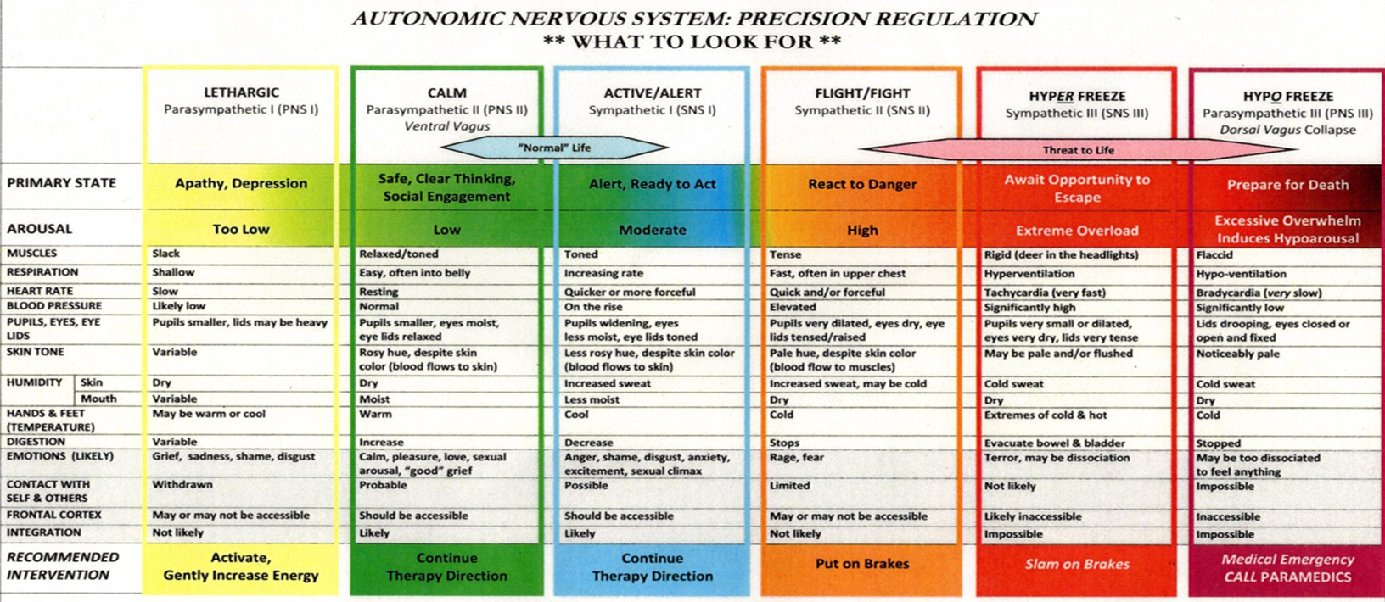
Polyvagal Theory The chart below adapted by Dr. Rothschild nicely demonstrates the shifting in body sensations, physiological symptoms, and emotions as we move between autonomic states (Rothschild, 2017).

Slide 6
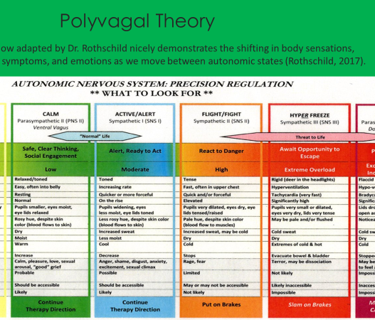
I have talked elsewhere about how trauma stores in the body as the famous Dr. Bessel van der Kolk has asserted in his excellent book, The Body Keeps the Score. Novel therapies such as Dr. Stephen Porges, Polyvagal Theory has given us excellent conceptualizations of this. So, IFS gives us a bridge to understand, appreciate, and treat the psychological manifestation of the underlying biological processes that are involved in trauma and addiction.

Slide 7
Some of the following slides are taken from the work of Dr. Dawn-Elise Snipes Click to the link below to listen to her superlative lecture: https://www.youtube.com/watch?v=LJHoW_bb5-M&ab_channel=DocSnipes

Slide 8
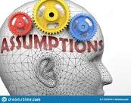
Basic Assumptions

Slide 9
The IFS Parts and Assumptions

Slide 10
Overview of IFS

Slide 11
These parts are encoded in implicit or procedural memory and become rather reflexive or procedural much like riding a bike or shooting an arrow.

Slide 12
IFS therapist, Cese Sykes LCSW, describes the IFS as three categories which comprise a system. If not in extreme roles they serve us well.

Slide 13
When psychological pain/trauma is extreme, these parts/roles become extreme, and they move form being adaptive to potentially destructive. Note that they are not bad, they are trying to help but they do potentially hurtful things in that effort to help.

Slide 14
Cese Sykes notes that in IFS, we treat a system, not a symptom.

Slide 15
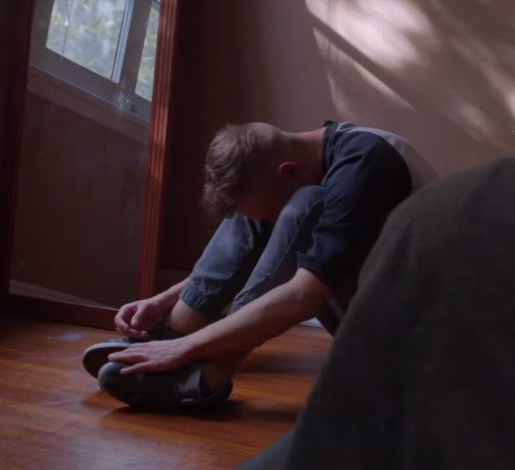
Exiles Early pain encodes deeply within us in implicit memory and becomes exiled from our “Self”

Slide 16
IFS Exiles

Slide 17
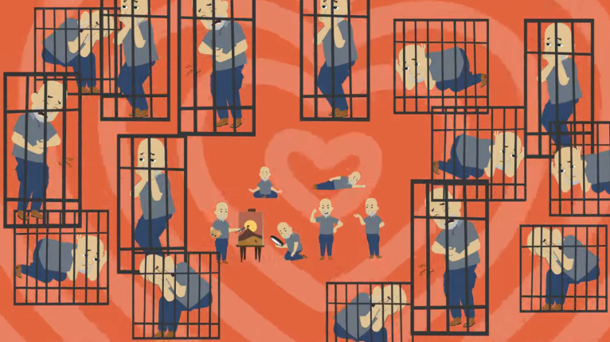
Poor exiles essentially get locked up

Slide 18
Exiled parts – not part of God’s plan.
“Exiles ore the tender, hurting, vulnerable parts of us that feel all of our difficult emotions:
Think shame, worthlessness, terror, grief, loss, depression, loneliness, anxiety, pain, powerlessness, fear, and isolation. We come by them honestly even though they were not part of God’s perfect plan” (Riemersma, 2020, p. 44).

Slide 20
IFS Firefighters

Slide 21
Firefighters taking charge of the pain by reactively acting out

Slide 22
IFS Self

Slide 23
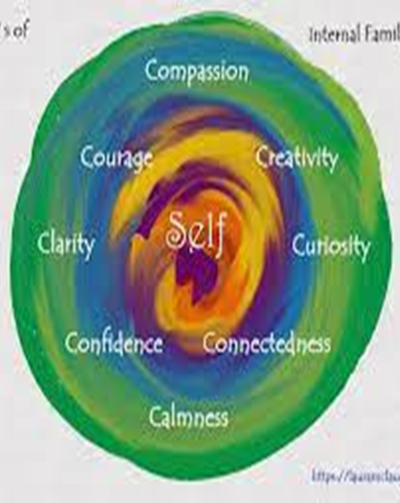
IFS’s 8 Cs correspond nicely to Galatians 5:22-23 Fruits of the Spirit: Love Joy Peace Forbearance Kindness Goodness Faithfulness Gentleness Self-control

Slide 24
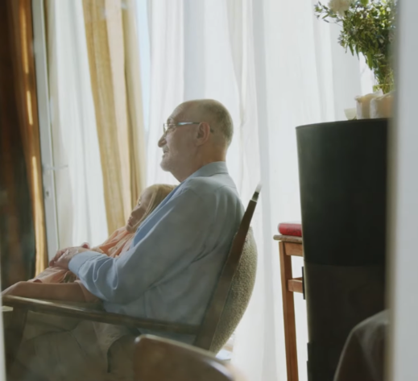
The integrated “Self” leads to inner peace, happiness, and the ability to connect healthily to others we care about and love

Slide 25
The Inner Critic
Parts that act as “Inner Critics” (using IFS language), appear to be a somewhat universal experience. In their milder manifestation, parts that criticize can be beneficial for you when they allow for the acknowledgment of mistakes and errors or the cultivation of positive change and humility.
Like all parts in IFS, “Inner Critics” have value and a positive intention. It’s when an “Inner Critic” moves into an extreme role, they can start to impede the individual’s ability to thrive, and the possible benefits of self-criticism may be overshadowed by possible harm to one’s well-being through internal turmoil.

Slide 26
Types of Inner Critics Sean Cuthbert, 2022 Australian Clinical Psychologist. Please click the link below to watch his excellent talk https://www.seancuthbert.com/post/types-of-inner-critic-in-internal-family-systems-ifs-therapy
The Perfectionist. This is one of the most common types of Inner Critic and its positive intent is usually something around trying to get you to do things perfectly to protect you from the judgement of others. Often these perfectionistic parts will have great difficulty in finishing something or putting it out into the world, believing that some added tinkering will make it better in the service of increasing your protection from negative feedback.
The Inner Controller. This critic is usually one that tries to control addictive impulses such as eating, drinking, drugs, sexual activity. It usually is polarized with a Firefighter (reactive) who it fears will take the person over and wreak havoc at any moment.
The Taskmaster. This type of critic pushes you to work hard to become successful in society. It is often polarized with a Procrastinator part that wants to give you a break so takes them off into distracting activities (like a You tube rabbit hole). This Taskmaster often acts undetected as its outcomes are often heavily rewarded by society. It ultimately holds extreme fears that you may be pretty lazy and will be judged as a failure if it does not push you to keep going.
The Underminer. This critic often will try and undermine your efforts and drain your self-esteem so that you won’t take any risks. This part may make brutal attacks on you with the positive intent of keeping you small and not take chances where you may experience negative feedback or failure, thereby avoiding the potential pain of this.

Slide 27
Types of Inner Critics – cont. Sean Cuthbert, 2022 Australian Clinical Psychologist. https://www.seancuthbert.com/post/types-of-inner-critic-in-internal-family-systems-ifs-therapy
The Destroyer. This may be one of the most destructive critics as it makes continued pervasive attacks on your self-worth, showering you with shame and making you feel inherently flawed. My experience of clients where The Destroyer is very active, they will compulsively apologize for themselves (and their very existence) or their posture will be slumped to avoid eye contact. They often have histories of extreme trauma (physical, sexual, emotional) and their Destroyer parts hold beliefs around it being safer or more preferable to not exist.
The Guilt-Tripper. This critic can take various forms. On the one hand it may hold you accountable for hurting others by making sure that behaviour/action is often front of mind in the service of that behaviour not being repeated. It may also hold fears about you being outcast as it holds you to standards of behaviour set by your family, community, or cultural group.
The Conformist. I see this critic as closely related, and often working with The Guilt-Tripper. The Conformist wants you to be part of a group and seeks to get you to be liked/admired as a way to protect against abandonment. This critic will often be polarized with parts that rebel or seek to act outside group norms, fearing that you’ll be rejected or abandoned. This may be particularly true in families where being your true self has been discouraged or actively punished.

Slide 28
Inner Critic – cont.
As you go through these descriptions of types of “Inner Critics”, you may like to check in and notice what’s happening inside as you read. You may notice parts of you right now that are judging or criticizing these “Inner Critics”.
A common phenomena in working with critics in IFS is that these critics will often get a lot of hate from other parts of the internal system, or these parts have their own critic parts that criticize them.
Think of it like a line of people, each yelling at the one in front of them! This may seem overly complex (and it is, because everyone’s neurobiology is complex), but usually all you need to do is work with the first critic and/or the one that criticizes it to start to create space for the internal relationships to be different (Sean Cuthbert, 2022 Australian Clinical Psychologist). https://www.seancuthbert.com/post/types-of-inner-critic-in-internal-family-systems-ifs-therapy ).

Slide 29
Goals of IFS Therapy
The goal of IFS is to help clients access Self so that they can heal wounded parts and bring their minds into balance.
To achieve balance and harmony within the internal system
To differentiate and elevate the Self so it can be an effective leader in the system
When the Self is in the lead, the parts will provide input to the Self but will respect the leadership and ultimate decision making of the Self.
All parts will exist and lend talents that reflect their non-extreme intentions.

Slide 30
In IFS, we learn to listen to the pain
I need to listen to my anger to know that I have been violated.
I need to listen to my anxiety to know that I have unresolved trauma that needs to be healed.
I need to listen to my depression to know that I need to care for my heat’s deepest wounds
I need to listen to my fear to know that I may need to create safety.
I need to listen to my stress and irritability to know that I’m out of balance and need rest or reprioritization (Riemersma, 2020, p 42).

Slide 31
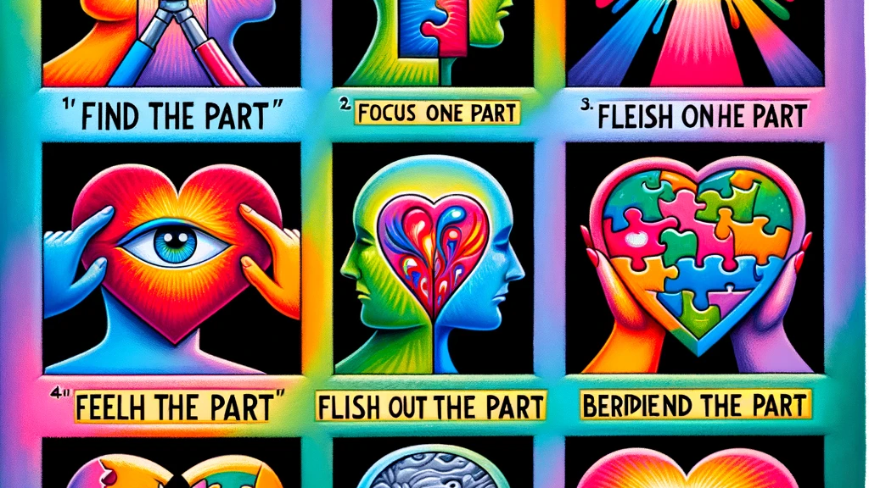
The Six Fs
Find: “Finding is the first step of the first stage of the therapy process. This stage is all about learning which part or parts need attention. During this stage it is best to just sit with the feelings and see what rises to the surface. Parts might make themselves known through images, emotions, or body sensations. This is not a stage for analysis, just a time to notice what’s coming up. Sometimes it’s good to talk through this stage, but it can also be a good moment to just sit quietly and see what parts make their presence known.
Focus: Once you’ve found the part, focus on it. Give it space to perform whatever its attention-seeking behaviors are, and give it space to exist. In this moment, it’s important to just let the part be there, to reassure it that it has your attention. Often parts are activated because their needs are not being acknowledged or met, and letting the part feel seen will make it easier for it to express itself authentically.
Flesh out: Now that it’s been given attention, the part collects into a set of bodily sensations and emotions that can be fleshed out into a self-contained entity. At this point, the part may start communicating and sending messages. You can give it space to tell you things, or to share the memories that are triggering it.

Slide 32
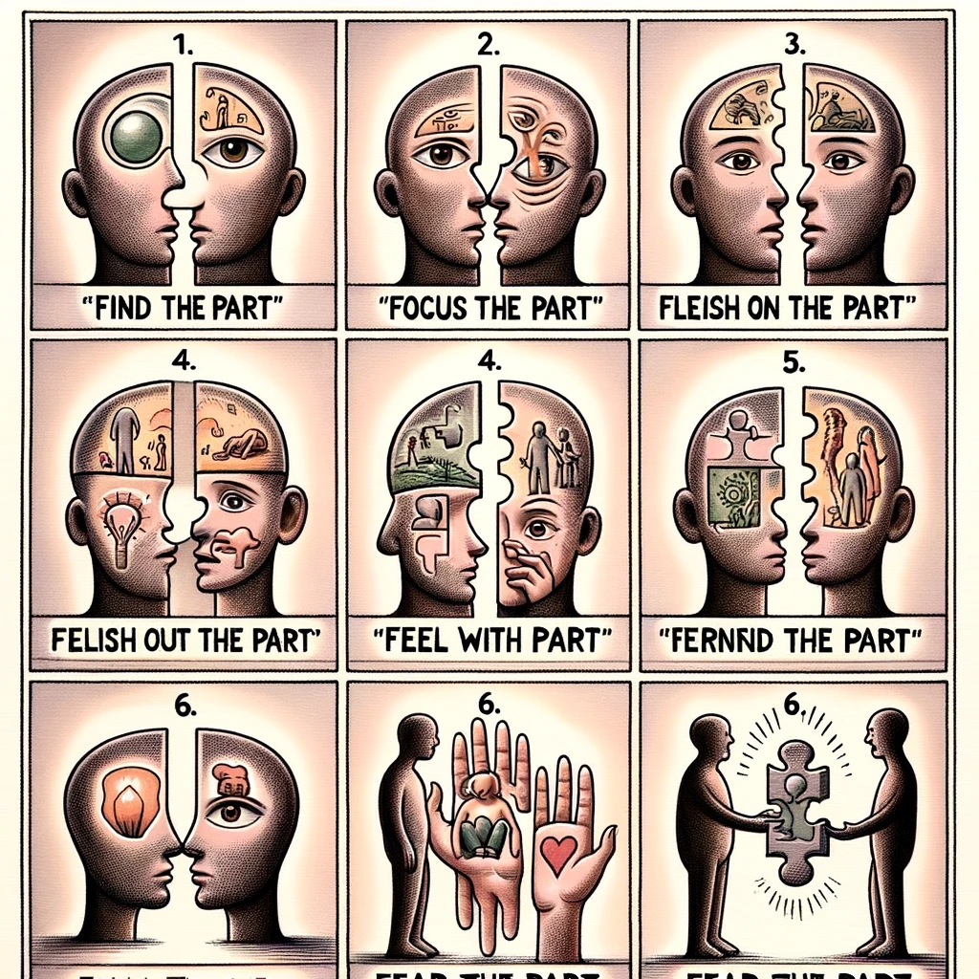
The Six Fs – cont.
4. Feel: This is the second stage. Now it’s important to see how other parts feel about this part’s presence. They might be upset that this specific part is getting attention or be alarmed that it will further imbalance the system. You must judge if you have enough core Self energy to move forward. If you don’t, you may have to do some work with other parts that are in the way before you can proceed.
Self-energy is measured with the 8 C’s: calm, compassion, curiosity, clarity, confidence, courage, creativity, and connection. If any of the 8 C’s are present when dealing with the part, it means Self is present and able to care for it. If more negative or extreme feelings like anger or anxiety are present it means that another protector part has stepped in to deal with the part you are trying to target.
5.Befriend: This is the start of stage 3. In the previous steps we created separation between the parts and Self and worked on creating active communication. This step is then about actually forming a relationship between this target part and Self. Work happens much more smoothly when the part trusts Self, so this is a good place to start forming that relationship. Ask the part about its function, what it’s trying to accomplish, and how it’s trying to help. Let it know that it is valued for its function, and that you respect how it’s keeping the system safe.Fear: What is this part protecting your from?
6. Fear: The final step for dealing with protector parts does not feel like a resolution. In this step, we ask the part what it’s afraid of. What does it think will happen if it stops being a protector? Here is often where we see the major signs of the exiled parts, those things we keep buried down deep so that they can’t overwhelm us. If the rest of the steps have been fully realized, Self will be able to have the part step aside so it can access whichever exile the protector was caring for. This stage opens a door for further exploration that is specific to working with exiled parts. There will be an article on this stage of IFS soon (ISSA Counseling https://issacounseling.com/contact-us/ ).

Slide 33
Jenna Riemersma – a leader in integrating IFS with Christian-Based thought
Anyone struggling with addictions knows the feeling of internal warfare. Parts of us hate the addiction while other parts of us keep pursuing it.
Internal Family Systems (IFS) is a therapy model that identifies these "parts" in us and how they wage war with each other. As these parts fight it out, our unwanted behavior rages and wreaks havoc in our lives.
In this video, IFS practitioner and therapist Jenna Riemersma talks about how IFS can help us battle our addictions and truly see how to welcome all parts of ourselves to the table.
Please click the link to watch her excellent interview on the Pure Desire Podcast:
https://www.youtube.com/watch?v=U0C2dLNWgPA&ab_channel=PureDesireMinistries

Slide 34
Lean into pain and ask three questions:
Much of medicine and even psychotherapy teaches us the wrong thin:, namely, to avoid or mitigate pain which keeps us stuck. IFS teaches us the contrary, that instead we must move toward the pain and listen to its valuable messages
What body or physical sensations do I notice and where do I feel them?
What does this pain or emotion want me to know?
What does this pain or emotion need me to do?
Click the link below for a wonderful guide on how to do this by Jenna (start at 48:20):
https://www.youtube.com/watch?v=U0C2dLNWgPA&ab_channel=PureDesireMinistries

Slide 35
Beginning to use the model

Slide 36
Beginning to use the model

Slide 37
Working with individuals

Slide 38
Working with individuals

Slide 39
Working with individuals

Slide 40
Working with individuals

Slide 41
IFS and Addiction Different “psychological definitions” of the addictive process as noted b Cece Sykes, LCSW

Slide 42
Judgment or Compassion in treating addiction?

Slide 43
In IFS treatment we focus on being in this together which is a nice paradigm shift.

Slide 44
In treating addiction, IFS helps the person “get in relationship” and not in “control.”

Slide 45
Help the client deal with common polarities – words and perspective matter.

Slide 46
Strengths of the IFS Model

Slide 47
A few of my favorite speakers on IFS. Please take a listen.
Jenna Riersmesma – Faith and IFS
https://www.youtube.com/watch?v=deqxDq9Xw6g&ab_channel=geoffreyholsclaw
Dr. Tori Olds https://www.youtube.com/watch?v=tNA5qTTxFFA&ab_channel=Dr.ToriOlds
Kenny Dennis – IFS for Kids
https://www.youtube.com/watch?v=Ji7bk3JfEmk&ab_channel=KennyDennis

