Slide 1
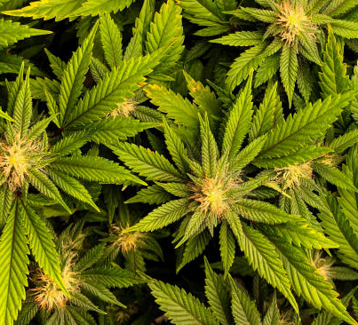
THC – The Good, the Bad, and the Ugly
Jeffrey E. Hansen, Ph.D.
Center for Connected Living, LLC
“The views expressed are those of the author and do not reflect the official policy of the Department of the Army, the Department of Defense or the U.S. Government.”

Slide 2
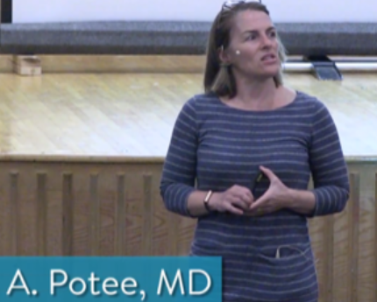


Highly recommended lectures on THC use and the sources for much of the content in this PowerPoint
Please click the link below to listen to addiction medicine physician Dr. Ruth Potee’s fantastic school talk on addiction and the teenage brain:
https://www.youtube.com/watch?v=25mK4yXzOkQ&ab_channel=1623Studios
Please click the link below to listen to Stanford neuroscientist. Dr. Andrew Huberman’s superlative lecture on the dangers of THC use. It the best and most thorough discussions on the topic that I have heard.
https://www.youtube.com/watch?v=gXvuJu1kt48&ab_channel=AndrewHuberman
Cannabis, It’s Complicated by Kim Porter who is an excellent advocate against teen use of THC. Please click the link below to listen:
https://www.youtube.com/watch?v=fdguiE_dTu0&t=2s&ab_channel=BeaPartoftheConversation

Slide 3
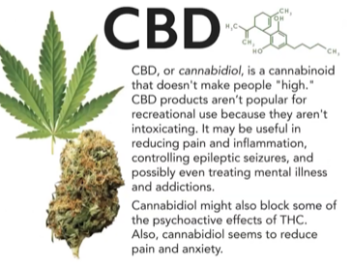
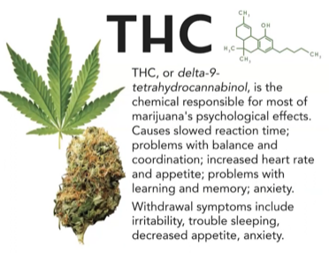
THC and its cousin, CBD

Slide 4
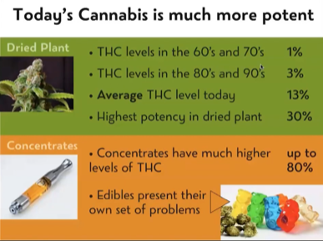

Today’s THC is not like what the good old hippies smoked

Slide 5
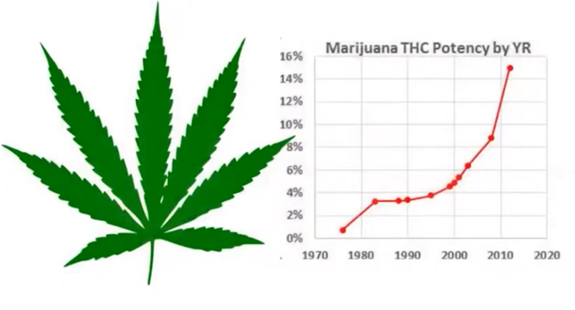
It just keeps getting stronger, hence, the impact on the brain and body greater.

Slide 6
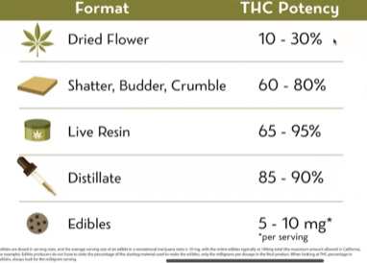
THC Potencies

Slide 7
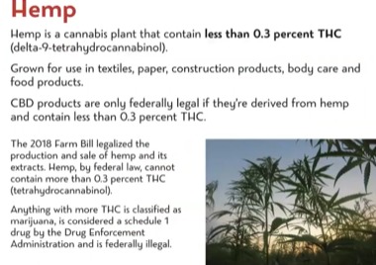
Hemp

Slide 8
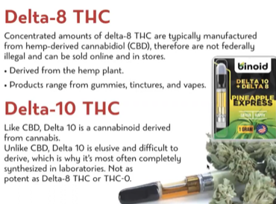
Delta-8 and Delta-10 THC

Slide 9
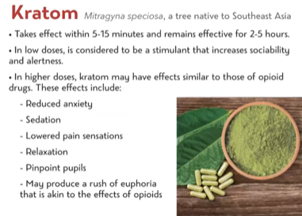
Kratom

Slide 10

The impact of THC on Brain Development
Using marijuana before age 18 may affect how the brain builds connections for functions like attention, memory, and learning. Marijuana's effects on attention, memory, and learning may last a long time or even be permanent

Slide 11
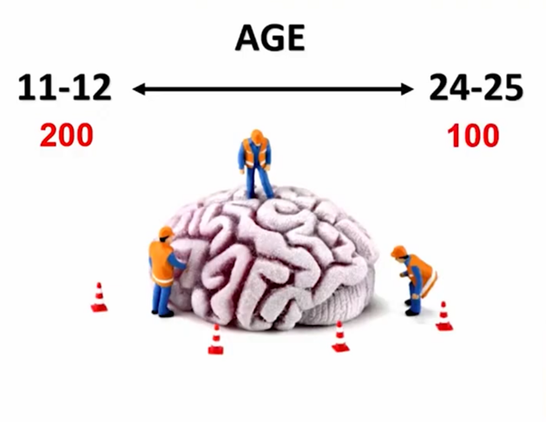
The Second Phase of Brain Growth
The second phase of brain growth starts at about 12 and continues to age 25. During this time, the brain prunes out little-used/unneeded neurons and the brain thus decreases from 200 billion to 100 billion neurons. During this time, pathways that are used myelinate to increase efficiency. So, ensure that a teen is learning and doing good things during this time as this will wire into what becomes the adult brain.

Slide 12

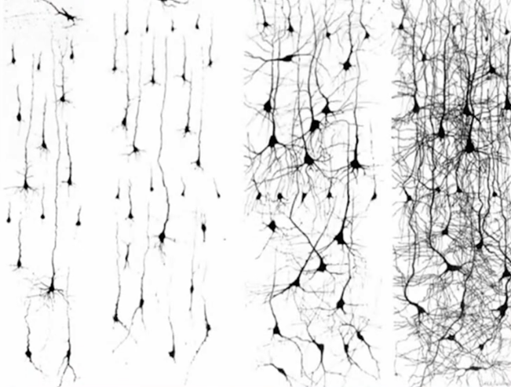
The infant neuron and its dendritic tree shown on the left is quite simple and you can see how its dendritic three increases in complexity across the lifespan.

Slide 13
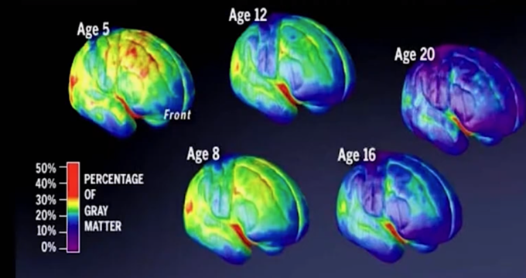
As the brain develops gray matter or unmyelinated neurons become myelinated to become white matter. This slide nicely how much growth occurs across childhood into early adulthood. THC and other drugs arrest this growth process.

Slide 14
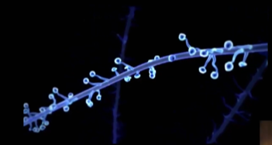
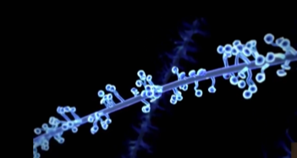
Excessive dopamine flow triggered by THX addiction causes dendritic growth on the neuron which results in permanent changes in the brain. This explains why craving is an everlasting consequence that must be respected throughout the lifetime.

Slide 15
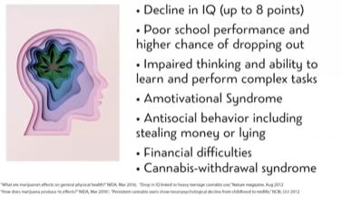
Long Term Impact on the Developing Brain

Slide 16
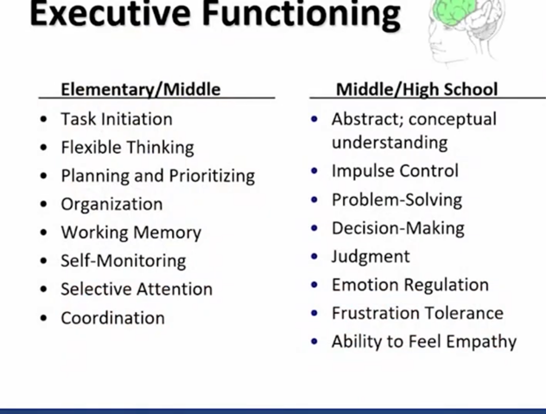
Dr. Collier notes that THC along with many other drugs slows or even arrests brain development, most specifically executive functioning which impacts your entire life.

Slide 17
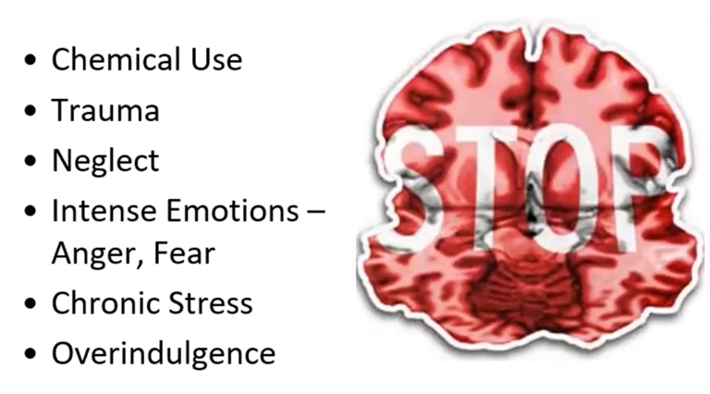
Dr. Collier summarizes the causes of arrested development.

Slide 18
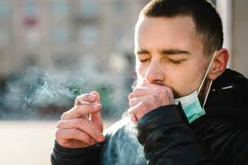

Alarming side effects of THC
Decreases gray matter in the prefrontal cortex – this may not be recoverable and is more problematic in children/teens as the brain is still developing.
When smoked or vaped, endothelial cells which form the inner lining of a blood vessel and provide an anticoagulant barrier between the vessel wall and blood are damaged which significantly increases the risk of stroke.
The brain down-regulates CB1 receptors (tolerance) so more is needed to achieve the same effect.
IQ decreased by an average of 8 points when you start as a teen.

Slide 19
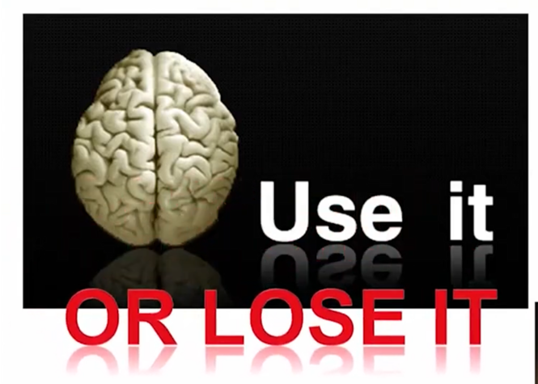
So – use the brain and wire in good stuff during adolescence or you lose good brain function in adulthood

Slide 20

Alarming Side Effects of Chronic THC USE
*Chronic is defined as 2 or more times per week
Decreases testosterone levels
Increases gynecomastia (breast tissue in males)
Decreases libido
Increases anxiety – typically after one year of use
4X more likely to develop Major Depressive Disorder
4X more likely to develop a psychotic disorder such as schizophrenia

Slide 21
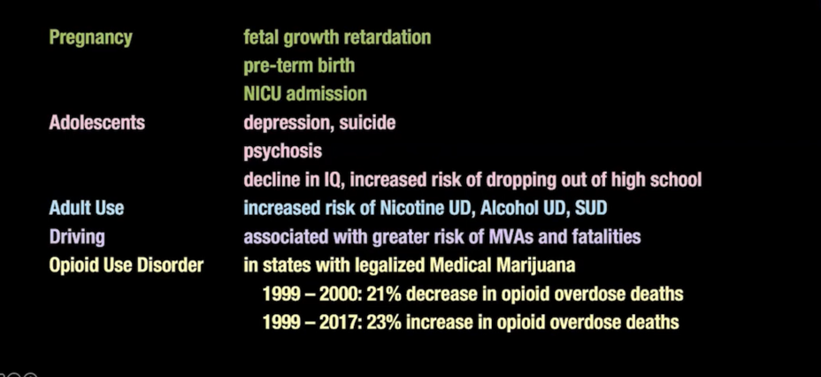
Per addictionologist, Dr. Kevin McCauley, cannabis legalization is not without risks.

Slide 22
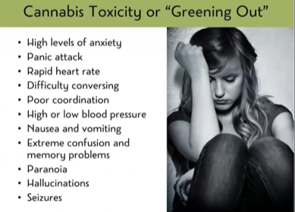
Cannabis Toxicity aka “Greening Out”

Slide 23

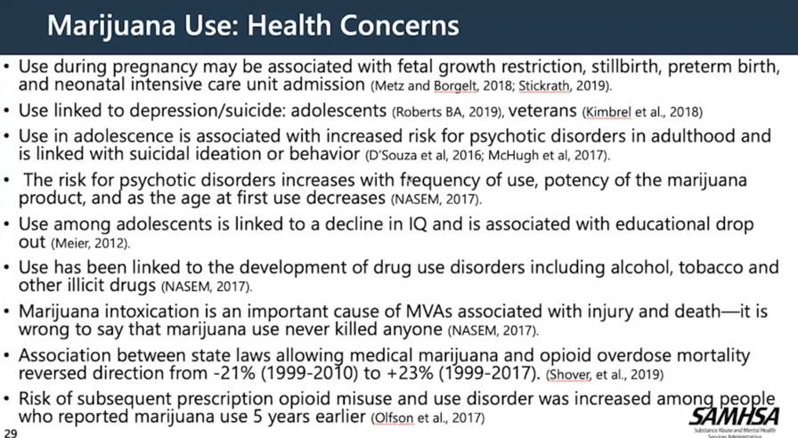
Medical health concerns with THC use per SAMHSA

Slide 24
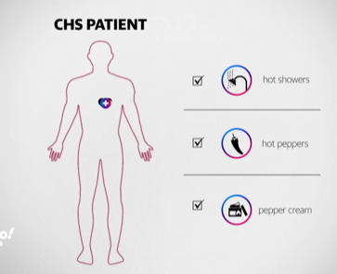


Cannabinoid hyperemesis syndrome (CHS) is a condition in which a patient experiences cyclical nausea, vomiting, and abdominal pain after using cannabis. It can in rare cases, kill you.
This disorder is characterized by 1) several years of preceding cannabis use, predating the onset of illness; 2) a cyclical pattern of hyperemesis every few weeks to months, at which time the patient is still using cannabis and 3) resolution of the symptoms after cessation of cannabis use, confirmed by a negative urine drug screen.
The almost pathognomic aspect of a patient's presenting history is that their symptoms are relieved by hot baths or shower or hot peppers.
Please click the link below to hear this mother’s story of the tragic loss of her son to CHS:
https://www.youtube.com/watch?v=E1laVfwz1yQ&ab_channel=YahooNews

Slide 25
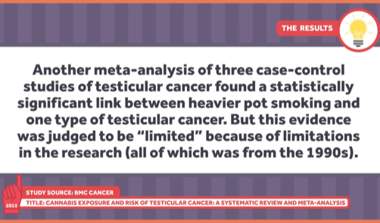
This is really scary! But to be fair, is not widely researched.

Slide 26

THC Facts
30 – 50% more addictive than nicotine
Anandamide was the first endocannabinoid to be discovered and participates in the body's endocannabinoid system by binding to cannabinoid receptor. This helps determine what gets pruned in the brain in adolescence. THC mimics and blocks this process and hence hampers brain maturation in teens.
For each year a teen delays THC use, there is an 8% decreased chance of becoming addicted to the substance as an adult.
There are two cannabinoid receptors: CB₁ and CB₂ .The CB₁ receptor is one of the most abundant G protein-coupled receptors (GPCRs) in the CNS and is found in particularly high levels in the neocortex, hippocampus, basal ganglia, cerebellum and brainstem. The CB₂ receptor exhibits a more defined pattern of expression in the brain than CB₁ receptors, and is found predominantly in cells and tissues of the immune system

Slide 27
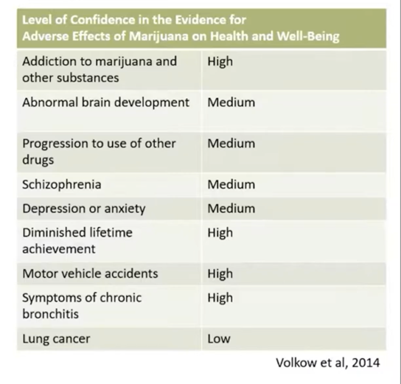

Summary of Adverse Effects of THC er Volcov et al., 2024 with Level of Confidence

Slide 28
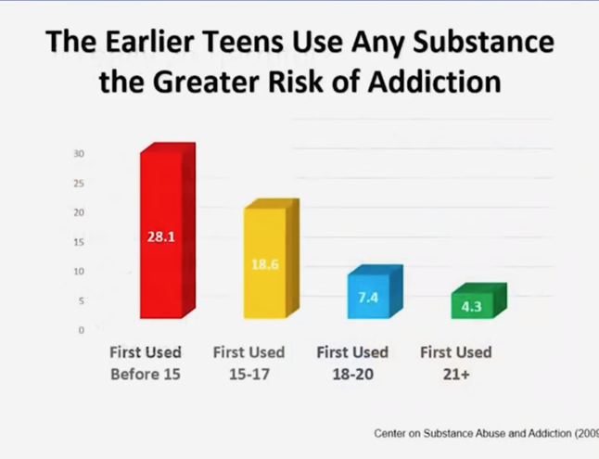
The earlier a teen uses THC, the greater risk of a lifetime addiction.

Slide 29
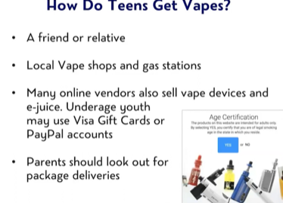
Getting Vapes is Easy

Slide 30
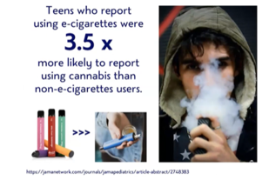
E-sigs and THC

Slide 31
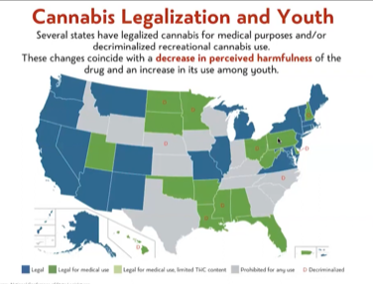
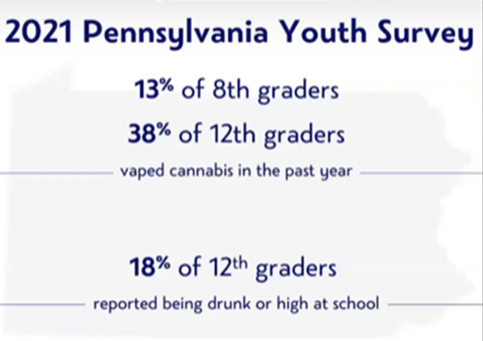
THC is legalizing everywhere with negative consequences

Slide 32
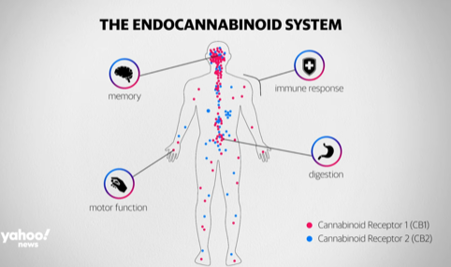
The Endocannabinoid System. Higher concentrations of CB1 in the brain and CB2 in the body.

Slide 33
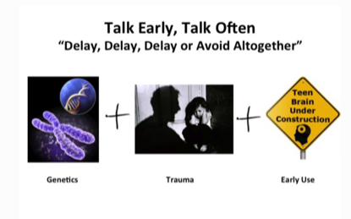

To teens: The longer you delay using the better. Avoidance is even better. Genetics, trauma, and age you start all add up to determine the likelihood you will become chronically addicted as an adult.
Many people use THC to quell the pain of trauma which works initially but, as in the Grim Reaper, always demands payment later, which far too often, is a lifetime of addiction and the problems it creates.

Slide 34
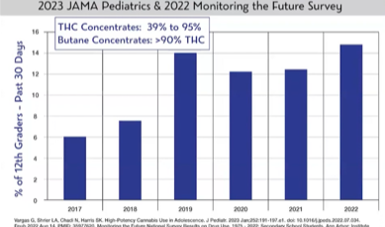
Increase in Adolescent Vaping of High Potency THC

Slide 35
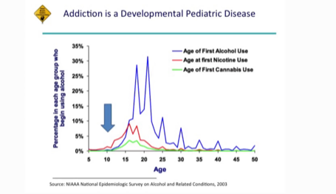
Entering the highway to addiction far too young!

Slide 36
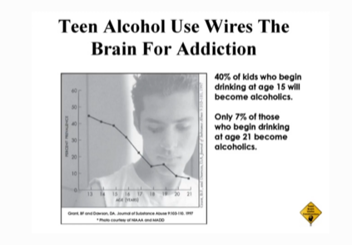
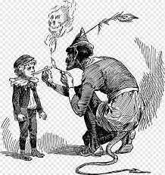
Use of substance in teens wires the developing teen brain for addiction. THC sellers know that if they get you early, they have a customer for life.

Slide 37
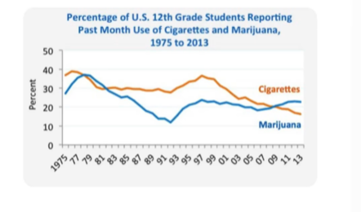
In 2009, THC use surpassed cigarette use in teens.

Slide 38
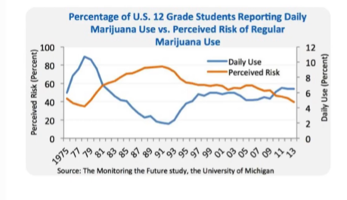
For teens: Since 2009, as your daily use increases, your perceived risk goes down. This is very dangerous - as you are sinking into quicksand, you fail to appreciate the increasing peril you are in.

Slide 39
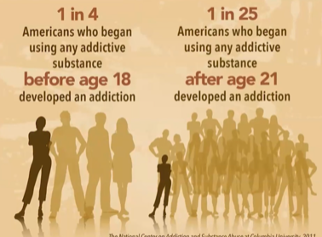
Start early and you risk being an addict for life!

