Slide 1
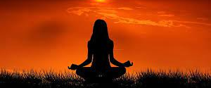
Spirituality and Health
Jeffrey E. Hansen, Ph.D.
Center for Connected Living, LLC

Slide 2
The content of this PowerPoint is adapted largely from the work of Dr. Lisa Miller’s presentations and books. Please click the links below to listen to Dr. Miller’s inspirational presentations: https://www.youtube.com/watch?v=BzAVgMdCrjM&ab_channel=TheAspenInstitute https://www.youtube.com/watch?v=6QLuBtkaKxA&ab_channel=U.S.ArmyChaplainCorps

Slide 3
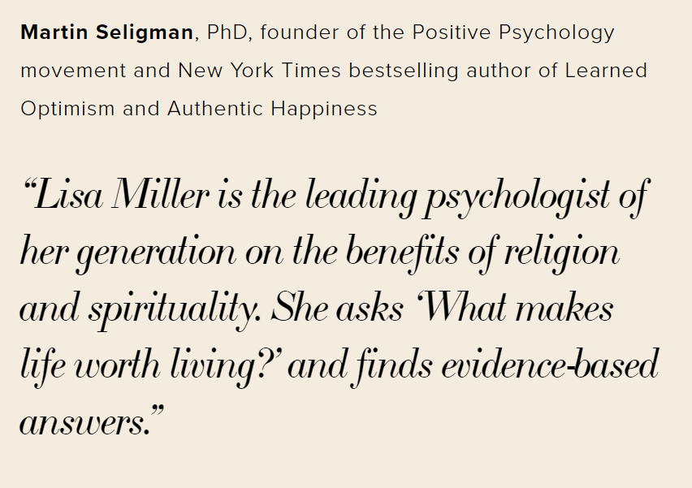
Dr. Miller’s Faith The patient walked out of the room with his shoulders slumped and Lisa, who is Jewish, saw an opportunity. This interview has been edited for length and clarity. Lisa Miller: I approached the unit chief and said, "I'm certainly not a rabbi, but I've been to two-and-a-half decades of Yom Kippur services.

Slide 4
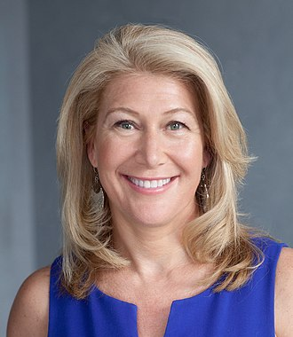
Who is Lisa Miller, Ph.D.?
Lisa Jane Miller is an American professor, researcher and clinical psychologist, best known as a research scholar on spirituality in psychology.[Miller is a tenured Full Professor at Columbia University, Teachers College in the Clinical Psychology Program and Founder of the Spirituality Mind Body Institute. Miller's published science on spirituality in renewal from addiction, depression and struggle has been reported in articles focusing on her research in the New York Times and the Wall Street Journal, as well as in television interviews and podcasts.
Early life and early career:
Miller obtained a bachelor's degree in Psychology from Yale University and a doctorate under Martin Seligman, founder of the positive psychology movement, at the University of Pennsylvania.
- Wikipedia

Slide 5
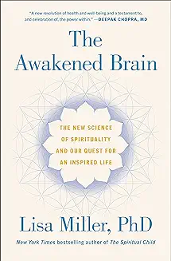
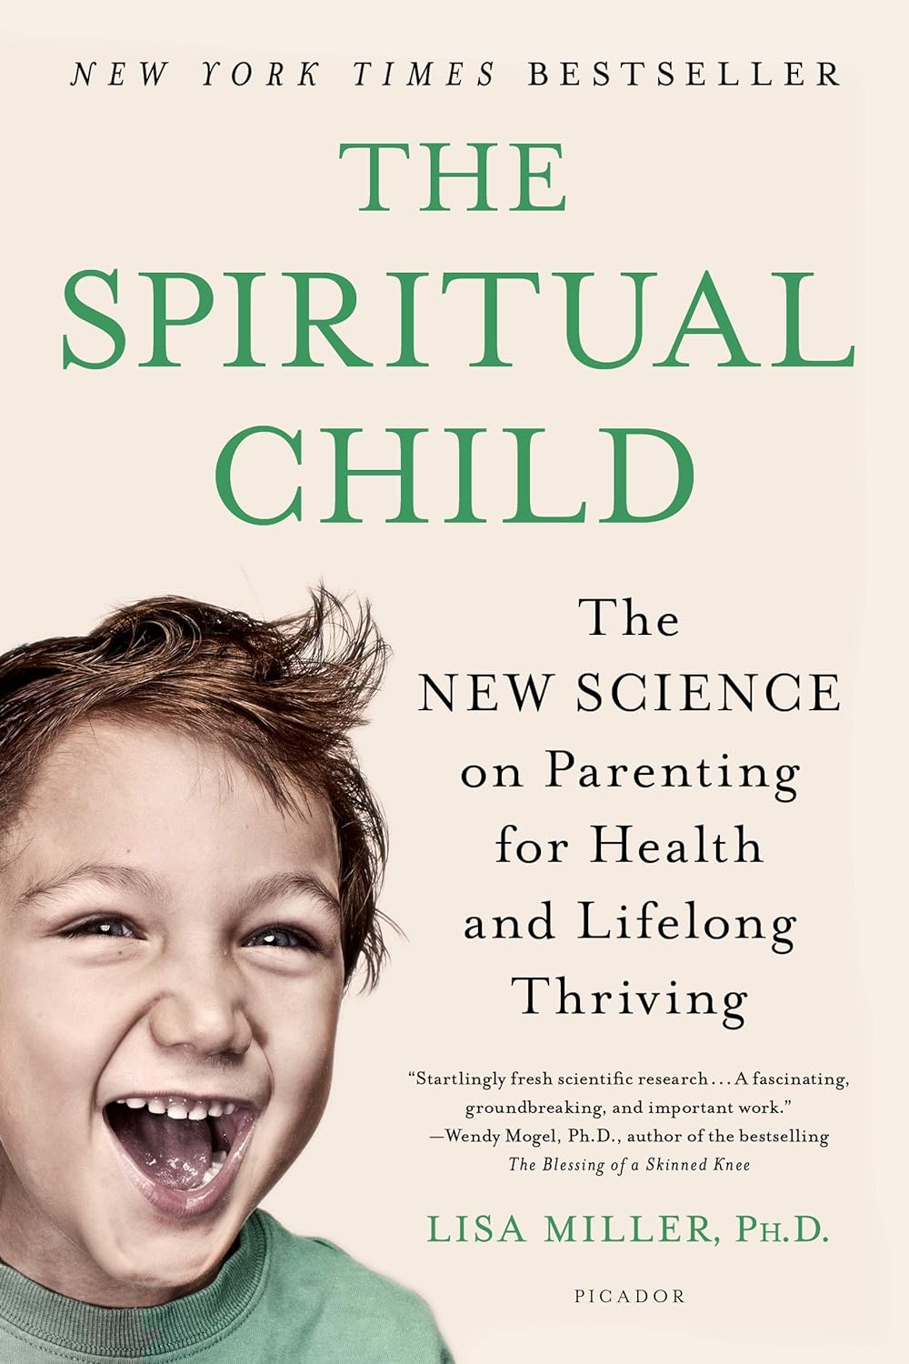
Dr. Miller’s books on Spirituality and Health

Slide 6
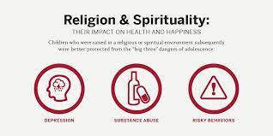
Dr. Miller report that research indicates incredible protective factors ensue with spirituality.

Slide 7
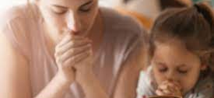
There is an additive protective factor when both mother and child share spirituality according to Dr. Miller’s research.

Slide 8
The research indicates that we are born spiritual in that we have an innate capacity for it. 1/3 heritable; 2/3 socialized There is a surge in adolescence (18-25) growth window.

Slide 9
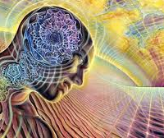
Dr. Miller asserts that the science reveals several impacts of spirituality on several key areas of functioning.

Slide 10
Dr. Miller reports research that indicate that spirituality leads to greater cortical thickness.

Slide 11
Critical thickness increases with spirituality.

Slide 12
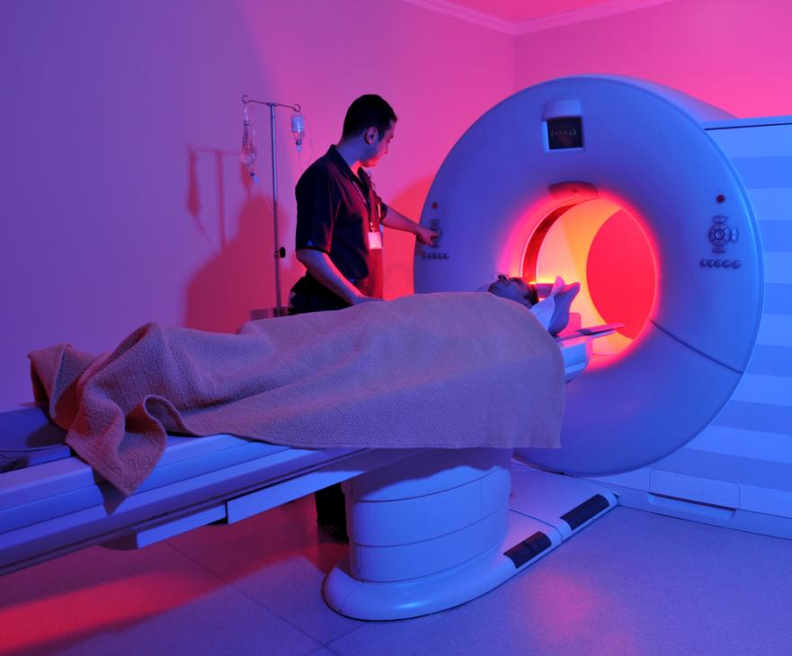
MRI Imaging of the spiritual brain.

Slide 13
Children from different cultures all reveal increases in positive virtues.

Slide 14
Dr. Miller notes research which indicates that high spirituality increases positive core values and life appreciation compared to low spirituality

Slide 15
The Effect of Spirituality on Health and Healing: A Critical Review for Athletic Trainers Brian E. Udermann, PhD, ATC “I (Dr. Udermann) searched MEDLINE from 1976 to 1999 using the terms “spirituality,” “religion,” “faith,” “healing,” and “health.””
Dr. Udermann’s conclusion, “Strong scientific evidence suggests that individuals who regularly participate in spiritual worship services or related activities and who feel strongly that spirituality or the presence of a higher being or power are sources of strength and comfort to them are healthier and possess greater healing capabilities. Numerous research investigations have reported positive correlations between spirituality and decreased rates of stroke, cancer, cardiovascular disease, hypertension, drug abuse, suicide, and general mortality. It has been suggested that faith is beneficial for health and healing because it helps people avoid unhealthy behaviors such as smoking and excessive drinking. However, studies designed to statistically control for such factors also report positive associations between spirituality and health in individuals with unhealthy behaviors.”
J Athl Train. 2000 Apr-Jun; 35(2): 194–197

Slide 16
Adolescents are wired for spirituality

Slide 17
Dr Miller reports research that indicates that adolescents who are raised with healthy spirituality have healthier core values (middle column) as opposed to those who are not (right column)

Slide 18
These positive core spiritual values tend to last a lifetime.

Slide 19
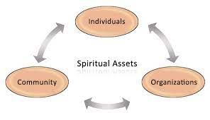
Dr. Miller contests that we need to build spiritual awareness into living

Slide 20
#1: I am aware that God or higher power hold me.

Slide 21
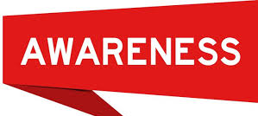
Dr. Miller asserts that spirituality involved three important awarenesses.

Slide 22
#2: I am part of the deep family of creation.

Slide 23
#3: I am guided by a loving presence.

Slide 24
Purpose of awareness.

Slide 25
Spiritual awareness opens us toward good things.

Slide 26
Spirituality and patient care per Dr. Harold Koenig.

Slide 27
Research out of Duke University and Harvard Medical School on Spirituality and Health

Slide 28
Although spirituality is common in the US, psychiatrists as compared to other physicians, have far more negative attitudes toward it.

Slide 29
Longitudinal drug trial have failed to largely failed to help Alzheimer Disease (AD) patients.

