Slide 1

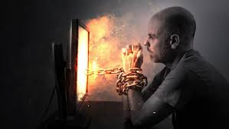
Polyvagal Theory – A New Model
Jeffrey E. Hansen, Ph.D.
Center for Connected Living, LLC
The greatest thing then, in all education, is to make our
nervous system our ally as opposed to our enemy
- William James
“The views expressed are those of the author and do not reflect the official policy of the Department of the Army, the Department of Defense, or the U.S. Government.”

Slide 2
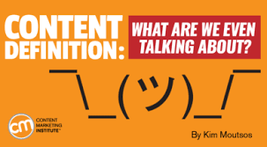
Definition Please
Emotional self-regulation or emotion regulation as defined by Wikipedia “is the ability to respond to the ongoing demands of experience with the range of emotions in a manner that is socially tolerable and sufficiently flexible to permit spontaneous reactions as well as the ability to delay spontaneous reactions as needed.
Emotion regulation is a complex process that involves initiating, inhibiting, or modulating one's state or behavior in a given situation – for example, the subjective experience (feelings), cognitive responses (thoughts), emotion-related physiological responses (heart rate or hormonal activity), and emotion-related behavior (bodily actions or expressions).
Functionally, emotion regulation can also refer to processes such as the tendency to focus one's attention on a task and the ability to suppress inappropriate behavior under instruction. Emotion regulation is a highly significant function in human life” (Wikipedia, 2020a).
As this definition suggests, emotional regulation is a really big deal and involves our thoughts, our bodies, and our feelings

Slide 3
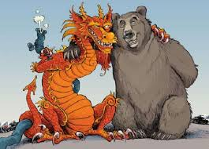
The Marriage of Triune Brain Theory and Polyvagal Theory
The greatest thing then, in all education, is to make our nervous system our ally as opposed to our enemy
- William James

Slide 4

The Marriage of Triune Brain Theory and Polyvagal Theory
In the last 10 years new and exciting neuroscience has emerged that helps us map out our physical, emotional, and cognitive responses to the world around us and provides us a way through the ensuing tempest within ourselves.
Dr. Barta (2018) proposes a model that demonstrates how the brain and the nervous system work together to fuel emotional dysregulation. In his model which he calls TINSA (Trauma Induced Sexual Addiction), he pairs some of the greatest minds in neurology and psychology to include:
  Dr. Stephen Porges’ Polyvagal Theory
  Dr. Paul Maclean’s Triune Brain Theory.

Slide 5
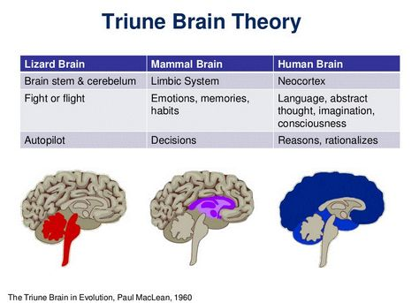
Triune Brain Theory
MacLean (2009) proposed that there are three distinct formations in our brain which are used in different situations for everyday survival purposes.
These specific structures developed sequentially on top of each other at different times during the evolution of the brain for the purposes of giving the organism the ability to survive during that period of time.
Even though the brain became more advanced and adaptive, the older more primitive structures of the brain still play an especially important role in thought, process, and behavior.
(For my Christian friends who might worry about this model contradicting sensitivities about creationism – not to worry. As explained by Dr. Andy Doan, M.D. Ph.D., ophthalmology surgeon and neuroscience researcher, and paraphrased by me, “God is very efficient, and He included in our more developed brain substructures that He already designed for lower life forms/animals. No need to re-do what was already perfect and efficient”).

Slide 6
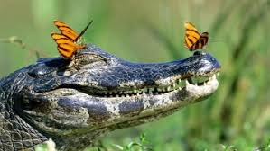
Triune Brain Theory
The Reptilian Brain (or Reptilian Complex):
As the name suggests, this is the most primitive brain and it developed about 500 million years ago in fish and later reptiles.
Its roles include sensation, instinctual reaction, breathing, temperature regulation. TINSA holds that the reptilian complex promotes certain survival functions as well, most specifically, immobilization or freeze.
We often see lizards, for example, freeze in the face of danger such as a lunch-starved predator in an instinctive reaction that can be life-saving (sadly for the lizard, it doesn’t always work, and he sometimes ends up being a snack anyway).

Slide 7
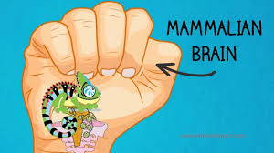
Triune Brain Theory
The Mammalian Brain (or Limbic System):
Later, about 150 million years ago, the limbic system first appeared in small animals.
This system developed as critters were able to move more freely about as they were now equipped with extremities.
As such, it often became necessary to either fight off or flee from would-be predators. In addition, the capacity to have memory and emotions developed.
This enabled the animal to control the body’s response to danger and to remember that danger as well as the ability to be vigilant and scan the surrounding environment for potential dangers. Like critters, we often revert to this neurological system when we act instinctively.

Slide 8
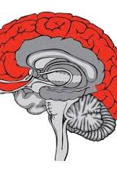
Triune Brain Theory
The Frontal Lobe (or Neocortex):
According to Maclean (1990), the frontal lobes came on board only about 2 or 3 million years ago.
As in the reptilian brain and the limbic system, the purpose of this brain formation is to react to and protect us from danger.
Unlike our more primitive neighbors, this system reacts consciously. Very importantly, there was a need to develop a system that made possible more “civilized” responses to threats and at the same time one that offered the possibility to connect to others for safety.
Therefore, the frontal lobe allows us to access a new way of surviving based on socialization. This makes it possible for us to use analysis, logic and decision-making, and this is what specifically separates us from other lower-ordered animals that rely on instincts alone for survival

Slide 9
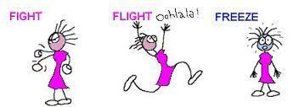
Triune Brain Theory – To Bring it Home
To bring it home, on topside we have the cortical brain consisting of the frontal lobe which is the most recently developed portion of the brain, i.e., the conscious, thinking brain.
At the bottom, we have our subcortical, unconscious brain, which is made up of the reptilian and limbic complexes and is directed largely by raw instinct and emotions which often results in immediate knee-jerk reactions that happen in a split second.
Barta (2018) informs us that, in the best of worlds, we try to lead with our frontal lobe and remain socially engaged if something threatening confronts us and in order think our way out of it, smile, and/or stay calm.
But in times of intense stress or in situations that remind us of past trauma, this survival mechanism is quickly overrun by earlier, more primitive survival strategies of our mammalian/limbic brain and our reptilian brain structures.
As such, when our prefrontal cortex fails us, the limbic system takes command and we are then rapidly sent into our fight-or-flight response and if this does not work and we cannot run away or fight our way out of it, the most primitive line of defense is deployed and we simply freeze, become immobilized, or completely collapse. This hijacking process can occur whether the threat is real or merely perceived (Barta, 2018).

Slide 10
Polyvagal Theory

Slide 11
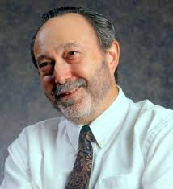
Polyvagal Theory
The Autonomic Nervous System
Dr. Steve Porges
The autonomic nervous system is our personal surveillance system.
In an effort to keep us out of danger, it is always on guard; asking the question, “Is this safe?” Its dedicated goal is to protect us by sensing safety and risk.
It achieves this by listening moment by moment to what is happening in and around our bodies and in the connections we have to others (Dana, 2018).
This listening happens far below awareness and far away from our conscious control.
Dr. Porges, understanding that this is not awareness that comes with perception which is conscious, coined the term neuroception to describe the way our autonomic nervous system scans for cues of safety, danger, and life threat, without involving the thinking parts of our brain or the unconscious parts of the brain (Porges, 2017).

Slide 12
Polyvagal Theory
The Autonomic Nervous System
Briefly stated, our response to threat will move us toward one of three defensive responses. Two of which keep us in perpetual defense and one of which moves us toward health and restoration.
Sympathetic Division: Prepares the body for stressful or emergency situations – fight or flight. The sympathetic nervous system originates in spinal nerves (nerves that arise from the spinal cord) and is our system of mobilization. The sympathetic nerves are found in the middle of our backs in the thoracic and lumbar regions of the spinal cord. There are two mobilization systems in our sympathetic nervous system.
  Sympathetic Adrenal Medullary (SAM): The SAM system is activated very quickly, within 100 milliseconds and brings up a burst adrenaline for a fast response to a stressor. SAM activation triggers a short-term and rapid response to a stressor which is followed by a return to regulation (Dana, 2018).
  Hypothalamic-Pituitary-Adrenal (HPA) Axis: The HPA axis takes over when the quick, adrenaline surge of energy of the SAM does not resolve the distress. The HPA releases cortisol (AKA stress hormone). This release takes longer and is much slower in taking effect, requiring minutes to take effect rather than seconds (Dana, 2018).

Slide 13
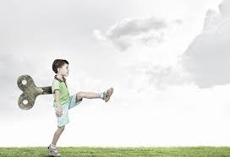
Polyvagal Theory
Sympathetic Division
The sympathetic division increases heart rate and the force of heart contractions and widens (dilates) the airways to make breathing easier.
It causes the body to release stored energy.
Muscular strength is increased. This division also causes palms to sweat, pupils to dilate, and hair to stand on end.
It slows body processes that are less important in emergencies, such as digestion and urination (Merck Manual).
When we are in this physical state, we can feel emotions such as fear and/or rage and, if extremely activated, absolute terror (Rothschild, 2017).

Slide 14
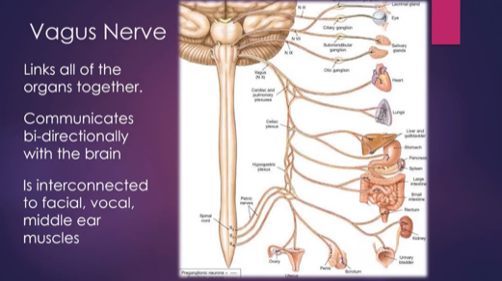
Polyvagal Theory
Parasympathetic Division
The parasympathetic division conserves and restores calm/homeostasis. It slows the heart rate and decreases blood pressure. It stimulates the digestive tract to process food and eliminate wastes. Energy from food is processed and used to restore and build tissues (Merck Manual).
Dr. Porges discovered that the parasympathetic division of the Autonomic Nervous System consists of two branches which lead to two different responses.
The main nerve in the parasympathetic nervous system is the 10th cranial nerve, aka vagus nerve, which is the largest of the 12 cranial nerves and has huge implications for our well-being and health.
The name vagus comes from the Latin word vagary which means wanderer, and this nerve is definitely a vagabond.
The vagus travels downward from the brainstem to the heart and stomach and then back upward to the face and its connection with other cranial nerves.
This amazing wandering nerve is a mixed nerve which communicates bidirectionally between the body and the brain. 80% percent of its fibers are sensory (afferent) sending information from the body to the brain, and 20% are motor (efferent), sending action information from the brain to the body (Dana, 2018).

Slide 15
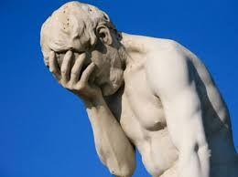
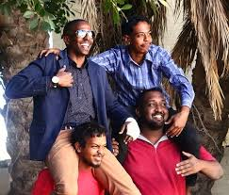
Polyvagal Theory - Parasympathetic Division
The vagus nerve has two very distinct branches: Dorsal vagal nerve and the ventral vagal nerve.
Dorsal Vagal Nerve: Barta (2018) notes that the most primitive form of defense occurs when the dorsal vagal nerve is activated.
  It is not sophisticated in that it is unmyelinated and slow. When activated, the dorsal vagal nerve promotes. shutdown, freeze, and collapse
  An example of this shutdown is when a gazelle, for example, is being stalked by a lion and when trapped with no possible way to flee, drops down and appears to be deader than a doornail.
  This is not a conscious process but is, rather, a very primitive and unconscious one. When we are in this physical state, we can feel emotions such as sadness, depression, grief, shame and/or disgust (Rothschild, 2017).
Ventral Vagal Nerve: Barta (2018) writes that the second response of our parasympathetic nervous system (the first being freeze and collapse as noted above) is responsible for our ability to engage socially and to handle social relationships.
  According to Barta, the social engagement system is controlled by our ventral vagus nerve which is a very smart myelinated nerve with a rapid response time. As such, it allows us to “know” if we are safe enough so we can calm our defenses through a process of “neuroception” which, as noted earlier, is translated as the brain’s ability to sense safety.
  This serves not only bonding needs but allows us to shift out of sympathetic arousal and move into parasympathetic calm or to downshift from activation to calm. When we are in this emotional state, we can feel emotions such as calm, pleasure, love, sexual arousal, and “good” grief (Rothschild, 2017).

Slide 16
Marriage of MacLean’s Triune Brain Theory with Porges’ Polyvagal Theory
Through the marriage of MacLean’s Triune Brain Theory with Porges’ Polyvagal Theory, we can explain how each part of the triune brain is correlated with the three responses of the autonomic nervous system (Barta, 2018).

Slide 17

Polyvagal Theory – The Stream
When we enter into an autonomic state, the information about that state travels up the automatic pathways to the brain where a story is drafted to make sense of the embodied experience/sensations.
In other words, the physiological state produced by the autonomic nervous system creates a psychological story.
Dana (2020) describes this as a metaphor of a stream where we can imagine the flow of experience. At the river’s source is neuroception and at the river’s mouth is the story. In between lie perception, autonomic state, feelings, and behavior. We are accustomed to entering in the river downstream with feeling and behavior, or story being at the fore.
However, neuroception takes place at the furthest point upstream. We need to make our way back to the starting point, leaving behind the story, behavior, and feelings in order to identify the state and bring perception or awareness to neuroception (Dana, 2020).
This has implications for treatment which we will discuss “downstream” in this paper.

Slide 18

Polyvagal Theory – Autopilot or the Choice of Connection?
So, our neurosystem, left on autopilot will, when we are faced with stress and threat, move us to either:
    (a) Sympathetic fight or flight which equates to extreme anxiety, anger, rage, and or terror or to
    (b) Dorsal vagal shutdown which leads to slowing down, withdrawal, and possibly even depression. If these modes of coping become excessive, we are at risk for potentially using maladaptive strategies such as addictions to quell the pain of negative physical symptoms, associated negative emotions, and/or complete withdrawal and possibly self-destructive behavior.
The best response is to activate our social engagement system of the ventral vagal pathway of the parasympathetic branch. In this state, our heart rate is regulated, our breath is full, we take in the faces of friends, and we can tune in to conversations and tune out distracting noises.

Slide 19
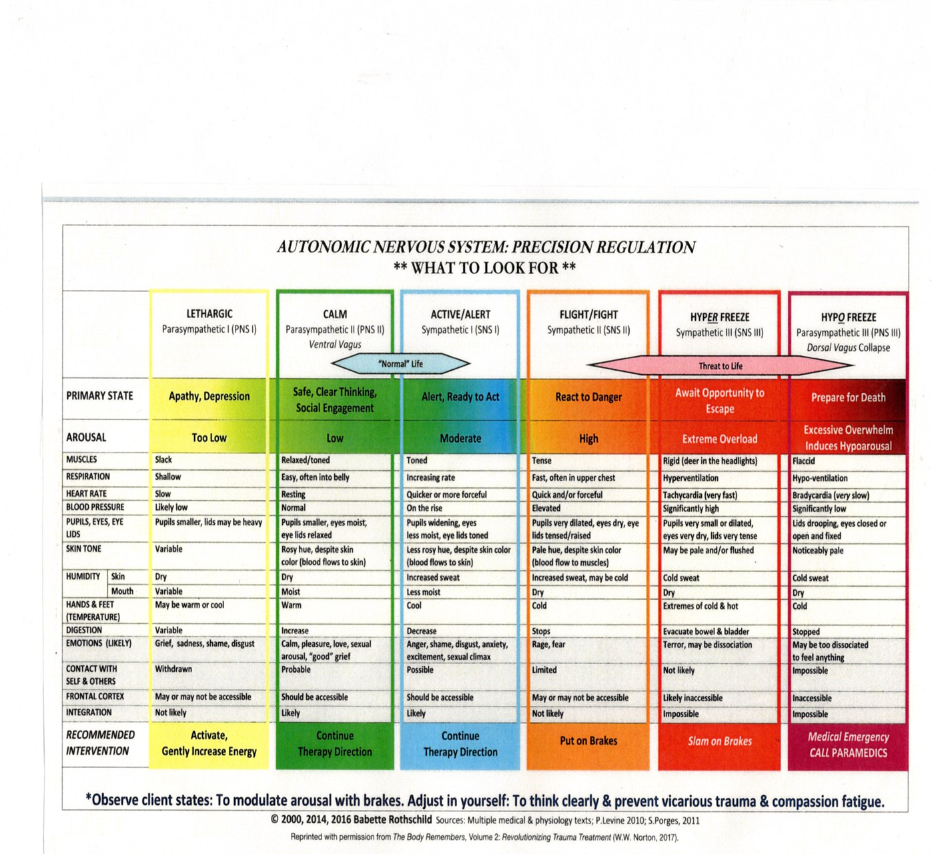
The chart below adapted by Dr. Rothschild nicely demonstrates the shifting in body sensations, physiological symptoms, and emotions as we move between autonomic states (Rothschild, 2017).
The Autonomic Nervous System Precision Regulation Chart is Available for purchase on Amazon for $8.99 (a very high recommend):
Babette Rothschild (2017) https://www.amazon.com/Autonomic-Nervous-System-Table-Laminated/dp/039371280X/ref=sr_1_15?dchild=1&keywords=deb+dana&qid=1590326813&s=books&sr=1-15

Slide 20
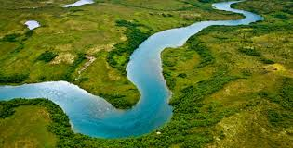
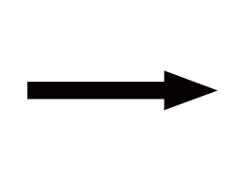
Polyvagal Theory and Treatment
Now that we have a new understanding of how our autonomic nervous system works, we can use this knowledge to restore to emotional, psychological, and physical health. Never before has a breakthrough in neuroscience offered such a paradigmatic shift of hope.
Neuroception Perception State Feelings Behavior Story

Slide 21
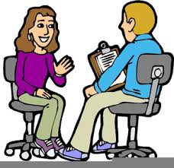
Polyvagal Theory and Treatment
So, the first step in healing is to move our neuroception - what our autonomic nervous system is automatically sensing regarding safety and danger without our awareness to perception to awareness or perception.
We can then appreciate what our physiological state is causing us to feel emotionally and subsequently change the behaviors that we then engage in.
The ensuing story or narrative we give to this process in an effort to make sense of what we are sensing and feeling, if positive and healthy, helps us correct our autonomic state.
On the other hand, if our narrative is false, as it often is (e.g., we often shame and blame ourselves or we catastrophize the situation), then our autonomic state becomes even more activated or shut down and our subsequent emotions become more anxious or depressed, respectively, and we enter into a negative feedback loop, a process that leads to emotional problems/illness and/or physical problems.

Slide 22
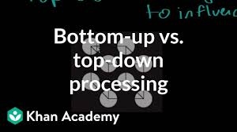
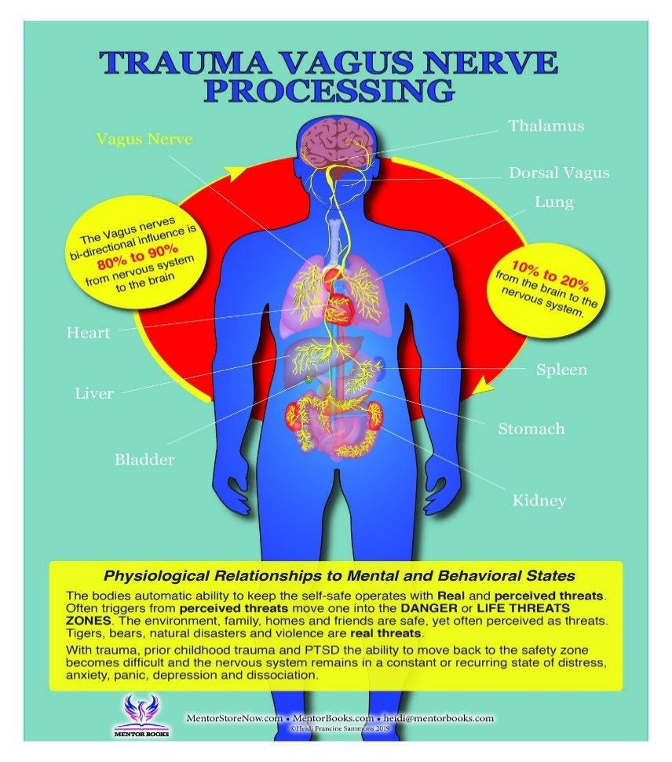
Polyvagal Theory and Treatment
There are two basic approaches to healing: Bottom up and Top Down:
  Bottom up entails working with the body more directly. It is important to appreciate that, as previously noted, 80 percent of the fibers in the vagus nerve are sensory in that they go from the organs to the brain and 20 present are motor in that they travel from the brain to various body organs. (Porges, 2017). This suggests that what our bodies tell us is indeed very important and we must make every effort to listen and heal on that level.
  Top down strategies which involve our thinking and hopefully more rational brain require a certain level of cognitive development and maturity so very young children may not be able to benefit from this approach (e.g., Cognitive Behavioral Therapy aka CBT).

Slide 23
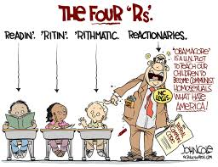
Polyvagal Theory and Treatment
As previously noted by Deb Dana, it is in a ventral vagal state and a neuroception of safety that brings the possibility for connection, curiosity, and change. She nicely presents a polyvagal approach which she calls the four R’s (the first three are bottom up and the last is bottom down (Dana, 2018):

Slide 24
Polyvagal Theory and Treatment
Recognize the Autonomic State
I recommend that we make the Autonomic Nervous System Precision Regulation Chart our companion as we use it to recognize where we, our children, and/or others are on that continuum. In so doing, we become able to make what is implicit (under the table and outside of our awareness) explicit (on the table and in our awareness).
We can use the color codes to describe for ourselves and for others where we and others are with just one neutral and non-judgmental word.
This is particularly helpful for children as well as this helps to give them a physical and emotional language that connect the mind with the body.

Slide 25
Polyvagal Theory and Treatment
Recognize the Autonomic State
If we find ourselves in the Orange Zone to Red Zone, we are overly activated and are prone to experience:
  Rapid heartrate
  Hyperventilation
  Panic attacks
  Inability to focus or follow through
  Distress in relationships
  Emotions of fear, terror, rage, anger
  Possible health consequences to include heart disease, high cholesterol, high blood pressure, weight gain, memory impairment, headaches, chronic neck shoulder and back tension, stomach problems, and increased vulnerability to illness (lower immune response) (Dana, 2018).

Slide 26
Polyvagal Theory and Treatment
Recognize the Autonomic State
If we find ourselves in the Yellow Zone, we are under-activated or shutdown and are prone to experience:
  Slow heartrate
  Shallow breathing
  Withdrawal from others
  Emotions of sadness, depression, shame, disgust
  Possible health consequences to include chronic fatigue, fibromyalgia, stomach problems, low blood pressure, type 2 diabetes, and weight gain (Dana, 2018)

Slide 27
Polyvagal Theory and Treatment
Recognize the Autonomic State
If we find ourselves in the Green Zone, we experience safety and connection and we are prone to experience:
Regulated heart rate (vagal brake lowers heartrate by 20 beats per minute)
Breath is full
Feeling regulated
We take in the faces of others
We can “tune in” to conversations and “tune out” distractions
We can see the “big picture”
We can connect with the world and the people in it
Able to reach out to others
Able to play and take time to enjoy life and others
Able to be productive in work
Able to organize and follow-through
Able to heal emotionally and physically
Emotions of happiness, joy, love, peace, calm
Possible health consequences include a healthy heart, regulated blood pressure, a healthy immune system, decreased vulnerability to illness, good digestion, quality sleep, and an overall sense of well-being (Dana, 2018)

Slide 28

Polyvagal Theory and Treatment
Respect the Adaptive Survival Response
One of the beautiful aspects of Polyvagal Theory is that it removes shame from the equation.
Dr. Porges kindly states in reference to clients, “I was going to say that depending on the age of my client, but actually, regardless of age, the first thing to convey to the client that they did not do anything wrong… If we want individuals to feel safe, we don’t accuse them of doing something wrong or bad. We explain to them how their body responded, how their responses are adaptive, how we need to appreciate this adaptive feature and how the client needs to understand that this adaptive feature is flexible and can change in different contexts.”(Porges, 2017, p. 121 - 122).
So, rather than shaming a woman for shutting down in dorsal vagal freeze when being molested or raped which will only fuel her shame, guilt, and emotional pain, we must compassionately inform her that her autonomic nervous system was brilliant and that, in reading the cues, immobilized her in a situation where fighting or fleeing could have possibly cost her her life.
Many a judge have literally ruined survivors of abuse by blaming them for not running or fighting and invalidated their trauma and thus failed to honor their day in court.

Slide 29
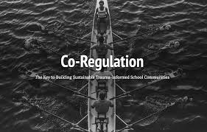
Polyvagal Theory and Treatment
Regulate or Co-regulate in a Ventral Vagal State
Once we recognize that we are dysregulated and we have pinpointed which defensive physiological state we are in and where we are on the emotional regulation continuum (see emotional regulation chart above) i.e., activation or slowing/shutting down, we can take action by using bottom-up self-regulation strategies and co-regulation strategies
As Herman Melville once wrote, “We cannot live for ourselves, a thousand fibers connect us.” Connection is a biological imperative according to Porges (2015).
Our autonomic nervous system longs for connection and it is through our biology that we are wired to connect. It is by means of co-regulation that we connect with others and create a shared sense of safety (Dana, 2020).
As specifically defined by Dr Porges, co-regulation is the mutual regulation of physiological states between individuals. In life, it occurs first between mother and infant but later extends to friends, partners, co-workers, and groups such as families to name a few (Porges, 2017).

Slide 30
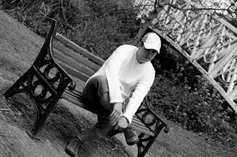
Polyvagal Theory and Treatment
Regulate or Co-regulate in a Ventral Vagal State
We humans are social creatures and “our nature is to recognize, interact, and form relationships” with others (Cacioppo & Cacioppo, 2014, p. 1).
As we know, babies need to connect for survival and positive co-regulation in low birthweight babies, in particular, leads to heart rate, temperature, and breathing stabilization, more organized sleep, rapid improvement in state regulation, and reduced mortality, severe illness, and infection (Jefferies, 2012).
Connection is a wired-in biological necessity and isolation or even the perception of social isolation can lead to a compromised ability to regulate our autonomic state which diminishes our physical and emotional well-being (Porges & Furman, 2011).
We can all appreciate that when we feel alone, we suffer. In a Ted Talk presentation, Cacioppo (2013) reported a rather shocking meta-analysis study of over 100,000 participants which found increased risks of dying early due to the following:
  Air pollution: 5% increased risk of dying early
  Obesity: 20% risk of dying early
  Alcoholism: 30% risk of dying early
  Loneliness: 45% risk of dying early

Slide 31
Polyvagal Theory and Treatment
Regulate or Co-regulate in a Ventral Vagal State
So, when we recognize that we are suffering and dysregulated it is very helpful and sometimes lifesaving to seek safe others.
Conversely, when we are emotionally regulated ourselves, we can offer our safe regulation to others, be they adults or children. This is a particularly important and essential component to good parenting.
We can gift our safe regulation to ourselves and to others by choosing the following strategies below. Remember, through the process of neuroception, others read our cues of safety just as we read theirs.
Quid pro quo, we receive back what he give and vice versa. We would do well to practice these strategies, so they become automatic whenever we move out of the green zone and want to return.

Slide 32

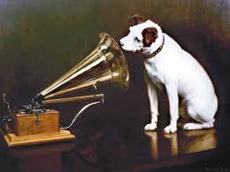
Polyvagal Theory and Treatment
Regulate or Co-regulate in a Ventral Vagal State
Kind eyes: As they say, they eyes are the window of the soul.
Modious voice: Speak with a more melodious voice, full of prosody and life.

Slide 33
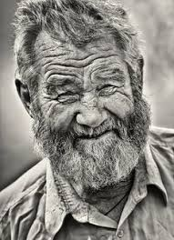
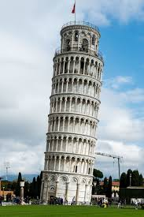
Polyvagal Theory and Treatment
Regulate or Co-regulate in a Ventral Vagal State
Avoid leaning in: Leaning in can be perceived as very threatening. Most of us don’t like it when others enter into 0ur personal space, particularly in western cultures, and the end result is typically defensive activation moving us toward fight or flight or less typically, occasional freeze responses.
Smiling mouth and eyes: Smile not only with your mouth but with your eyes. Whether or not we are aware, our neuroception scans for congruence between the smiling mouth and smiling eyes. Crow’s feet wrinkles are testament to someone who lives a more joyful life. So maybe reconsider that Botox.

Slide 34
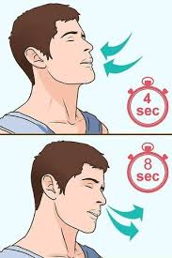

Polyvagal Theory and Treatment
Regulate or Co-regulate in a Ventral Vagal State
Slow and low Breathing: Our lungs are the only internal body organ that we can directly control, and proper breathing has a huge impact our health. Breathe slowly with exhalations longer than inhalations – breathing out slowly accentuates relaxation and actually can slow our heart rate by 20 beats per minutes (vagal brake).
\
Heartfelt positive emotions: As we breathe, we should try to bring positive emotions such as gratitude, joy, and love, or any positive experience or memory into our heart. The importance of positive emotions in the heart is now supported by the latest neuroscience. The electromagnetic field of the heart can now be measured and extends outward to a distance of about three to five feet as compared to that of the brain which extends only 2 to 4 inches.

Slide 35
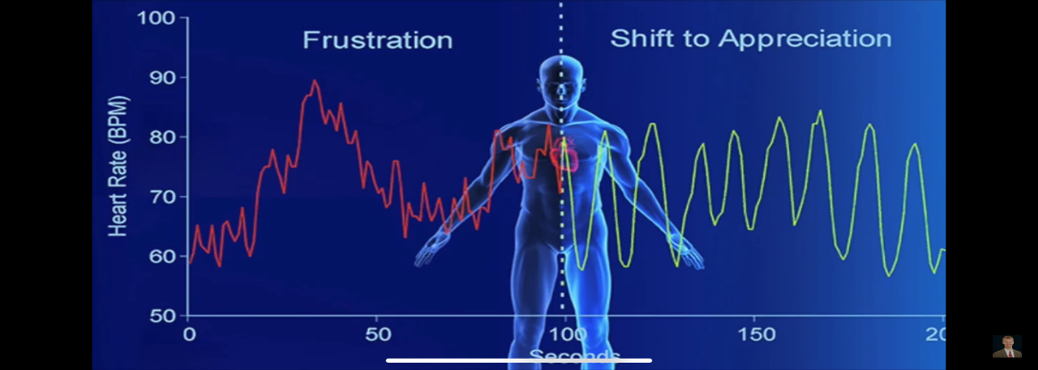
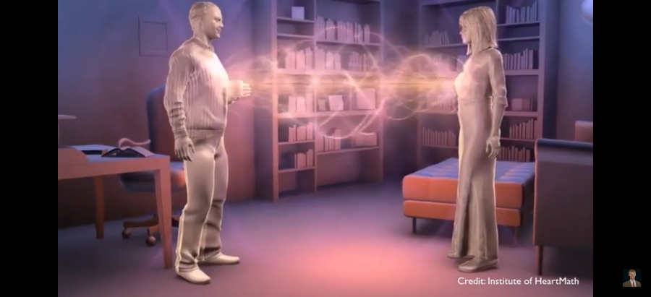
Polyvagal Theory and Treatment
Regulate or Co-regulate in a Ventral Vagal State
Heartfelt positive emotions: When we focus on positive emotions, our heart radiates a nicely coherent wave as compared to a dysregulated wave when our emotions are negative. This has impact on not only our emotional and physical health but the health of others (HeartMath Institute, 2020). Moreover, the heart has over 40,000 cells called sensory neurites which are very similar to the cells in the brain and there is evidence that the heart has a certain capacity for some types of memory as well as a gut level wisdom that guides us (Dispenza & Braden, 2019).
\

Slide 36
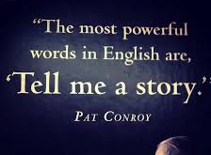
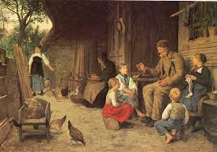
Polyvagal Theory and Treatment
Re-story
Now that we or ourselves and our loved ones are in a more regulated state by use of the bottom-up strategies discussed above, we should be more settled and thus, more able to use top-down strategies and correct the narrative or re-story the situation, be it a current event or something in our distant past (Dana, 2018, 2020; Kain, 2018). We humans by nature are meaning-making machines, autonomically pulled to the story (Dana, 2020).
Sadly, our narrative is often negative as there is a bias toward the negative (Hanson & Mendius, 2009). Although this tendency to see the negative in our circumstances and in ourselves might have a survival advantage in that we will be vigilant for the tiger, expecting him to eat us when we are in the wild, it works against us when there is no threat.
Additionally, victims of shock or acute trauma are particularly vulnerable to creating false narratives about themselves and the world around them (Porges, 2017; Dana, 2018, Kain & Terrell, 2018). In a more regulated state, we are safe to possibly do a Ctrl-Alt-Del or reset on the old story and rewrite a new or revised version that better reflects our past or current autonomic adventure, one that allows us to accept and appreciate the heroic nature of our autonomic nervous system that enabled us to survive through the pain and/or trauma of the past and embrace the beauty and joy of what we now have and the bright future that lies ahead.

Slide 37
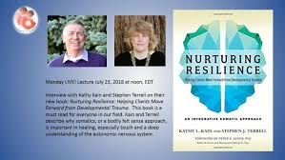
Polyvagal Theory and Treatment
Re-story
As Drs. Kain and Terrell eloquently write, “As our capacity increases, our narratives are likely to change, to include the sense of success at meeting challenges, of developing curiosity, or of a willingness to explore. Eventually, our narratives may also include access to a sense of safety and connection. Rather than I am constantly afraid and unhappy, a client will begin to tell himself a different story: I am stronger than I thought and able to meet challenges with greater balance and success” (Kain & Terrell, 2018, pgs. 101-192).
They add, “At the same time, our somatic narratives will begin to change. We may literally experience changes in our symptoms – decreased inflammation, less pain, fewer migraines. Our illness narratives my alter to include the possibility of being free of pain, free of symptoms that have beleaguered us for most of our lives” Kain & Terrell, 2018, p 192).

Slide 38

Conclusion
  So, thank you for taking a walk with me. We all struggle with managing and regulating our emotions. It is just part of the human condition. For some lucky few, who have inherited healthy genes and epigenomes, enjoyed the best of secure attachment early in life, experienced few Adverse Child Experiences while growing up, and lived connectedly, emotional regulation comes much easier. But most of us, to some degree, have taken on damage which has impacted on our ability to manage the emotional tempest within us and we are instead managed by it. No matter how bad our lives previous to this moment might have been, we can heal, we can restore our mind, body, and soul. \Keep looking up, keep learning, keep persevering. You can do it, connected with all good things.
  Jeff

Slide 39
Emotional regulation
17 August 2020 Draft – Hansen, J - updated

