Slide 1
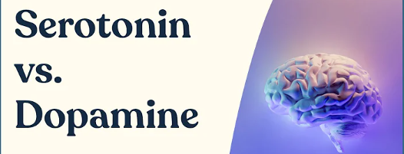
Serotonin vs Dopamine and the impact of Cortisol - Dr. Robert Lustig
Jeffrey E. Hansen, Ph.D.
Center for Connected Living, LLC

Slide 2
Serotonin vs Dopamine and the impact of Cortisol
Serotonin vs. dopamine explained by Dr. Robert Lustig author of "The Hacking of the American Mind: The Science Behind the Corporate Takeover of Our Bodies and Brains".
He explains the 7 key differences between pleasure and happiness and discusses the basic brain mechanisms behind various addictive products that are hacking our reward centers.
Please click the link below to watch this compelling video:
https://www.youtube.com/watch?v=A3svaOilIis&ab_channel=FitMind

Slide 3
Too much cortisol due to stress
Cortisol, the stress hormone, shuts down the prefrontal cortex which is the part of the brain that controls executive functioning. Our ability to control the primitive brain diminishes as the brain now has not brakes so we lose our ability to say no to addiction. This condition has been called hypofrontality or executive dysfunction syndrome.
This lack of brakes on seeking pleasure drives more dopamine which leads to runaway addiction.
When dopamine runs too hot, the protective mechanism of the brain downregulates post synaptic receptors for dopamine, so we need more and more dopamine just to get back to baseline. This is called tolerance.

Slide 4
Dopaminergic Downregulation at the Synapse

Slide 5
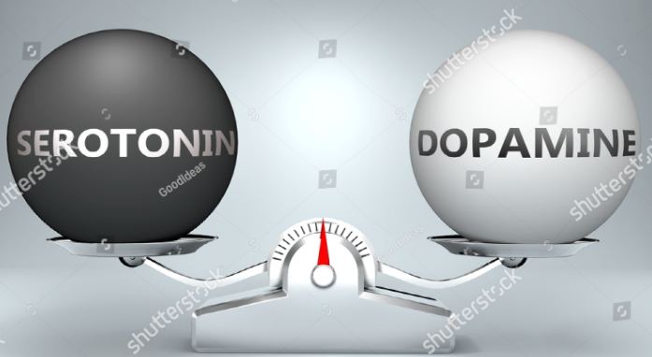
7 Differences between Pleasure and Happiness
Pleasure is short-term; happiness is long-term.
Pleasure is visceral, you feel it in your body, happiness is ethereal, you feel it above the neck.
Pleasure is taken, like from a casino; happiness is given, like to Habitat for Humanity.
Pleasure is achieved alone; happiness is attained in social groups, like a birthday party.
Pleasure is achieved in substances, like cocaine; happiness is never achieved in substances.
Pleasure is addictive; happiness is never addictive.
Pleasure is dopamine-driven; happiness is serotonin-driven.

